Slide 1

Web scraping using python
Topic
IPL Players stats analysis
Presented by:
Karthick R

Slide 2
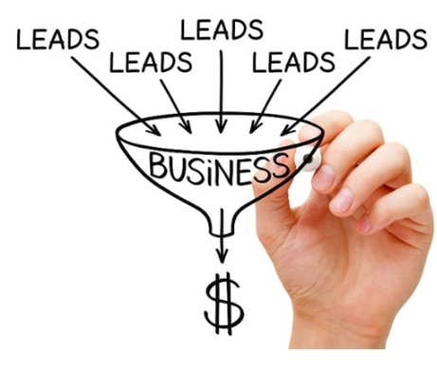
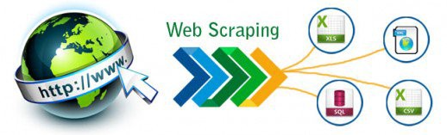
What is Web Scraping and Why is It Important?
Web scraping, or web data extraction is data scraping used for extra
This is integral to the process because it allows quick and efficient extraction of data in the form of news from different sources.

Slide 3
Data Extraction and Cleaning
Locating URL’s for extracting data
Use requests to make a GET HTTP requests for the URL. It retrieves the HTML data that the server sends back and stores that data in a Python object.
Parse HTML Code with Beautiful Soup
Find Elements by Class Name and Text Content
Removed the unwanted space in data content and saved in DataFrame
Store the data in csv
Read the csv
Remove the blank space filled with Nan using regex function
Extracted the required data for analysis using python tools and function

Slide 4
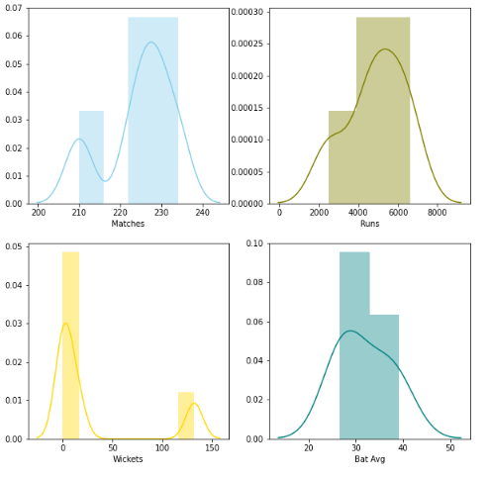
Data Visualisation
Analysis of cricketer’s performance

Slide 5
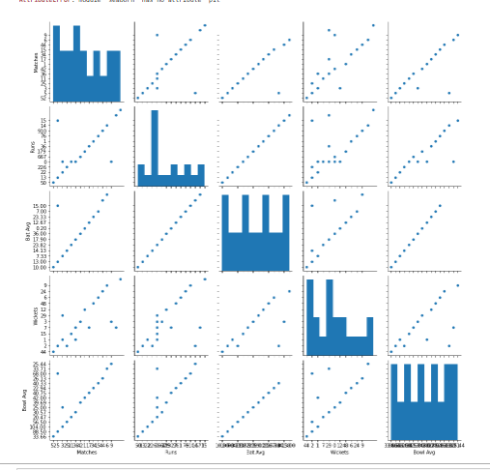
Pair plot

Slide 6
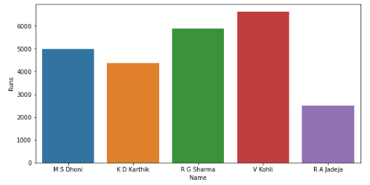
Analysis
TOP 5 MOST MATCHES PLAYED
Virat is scored highest runs among others

Slide 7
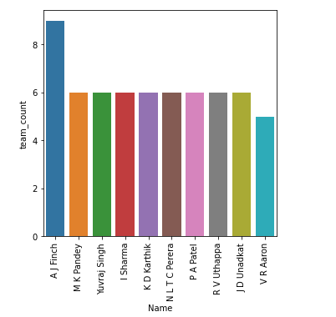
MOST TIMES PLAYER PICKED BY OTHER TEAMS
Finch is played 9 different teams than others

Slide 8
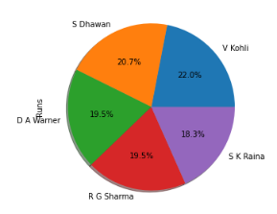
Top 5 total runs scored players
Virat Kohli
S Dhawan
D A warner
R Sharma
S K Raina

Slide 9
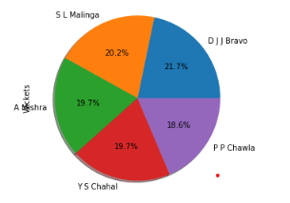
Top 5 Wicket-takers.
D J Bravo
S L Malinga
A Mishra
Y S Chahal
P Chawla

Slide 10
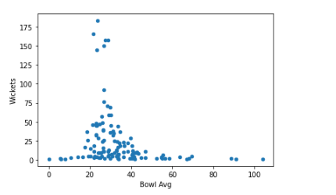
Scatter plot for wickets
This plot is represent scatter plot between wkts and bowl avg for 200 players

Slide 11
Conclusion
Best player :The best player taken by who is having good average in bating average and bowling average
The best player is “S K RAINA”
Best batsman: who played with good bating average and score
The best batsman is “D warner”
Best Bowler : who played with good bowl average and wickets
The best bowler is “S L Malinga”

Slide 12

THANK YOU

